Slide 1
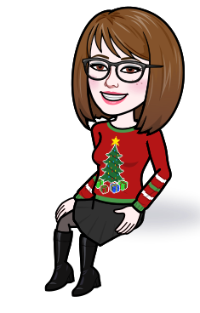
Welcome to ENL with Ms. Sun!
Find our work, meetings and announcements on:
jsun@hempsteadschools.org

